Slide 1

Chapter 3
What is
a string?

Slide 2


EXPLAIN
String value
5 MIN
CLASS
A string is a value that contains a sequence of characters
myString = "python"
myString is a string of 6 characters

Slide 3
EXPLAIN
String value
5 MIN
CLASS
A string value must start/end with a quote
Start quote
End quote
"python"

Slide 4
EXPLAIN
Type of values we know
5 MIN
CLASS
integer
decimal
Type | Possible values
Number | 1 , 3, 4.58
Boolean | True, False
String | "bibi" "Ronan" "Python is nice"
Uppercases !!
Start and end quotes !

Slide 5

EXPLAIN
len ( )
"toto"
5 MIN
CLASS
4
"toto"
4
LEN
Len is a machine to get the number of characters

Slide 6

QUIZ
How to get the number of characters
in a string : len(xxx)
5 MIN
1
x = "hello!"
nbCharacters = len(x)
print(nbCharacters)
What will be the result ?

Slide 7
EXPLORE
How to concatenate 2 strings together?
5 MIN
1
a = "ratha"
b = "Jeanne" c = a + b
print(c)
What will be the result ?

Slide 8
EXPLAIN
What is a carriage return ?
5 MIN
CLASS
A carriage return is a control character to go to the next line in the console
"aa\nbb"
aa
bb

Slide 9
EXPLAIN
A control character is composed of:
5 MIN
CLASS
A slash
A letter
\n
A control character is ONE character: its length is 1 !!

Slide 10
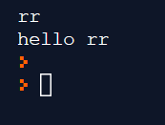
EXPLORE
5 MIN
1
How to enter a string in the console
myName = input()
print("hello " + myName )

Slide 11
EXPLAIN
By default Python add a carriage return at the end
5 MIN
CLASS
print("aaaa")
print("bbb")
aaaa
bbb
"aaaa\n"
"bbb\n"
"
If you don’t want it, just tell it :
print("aaaa", end="")
print("bbb", end="")
"aaaa"
"bbb"
aaaabbb

Slide 12
The console

Slide 13
EXPLAIN
What is the console, what is the code ?
5 MIN
CLASS
CODE
CONSOLE
print("Hello")
Hello
2
>
QUOTE
QUOTE
print(2);

Slide 14
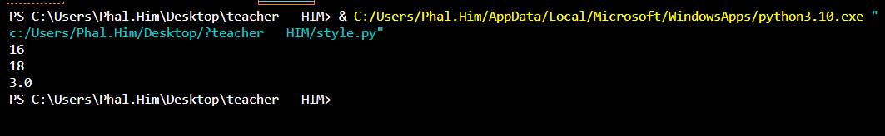
QUIZ
What this code will display on the console ?
5 MIN
CLASS
bob = 16
print( bob )
print( bob + 2 )
print( ( bob + 2) / 6 )
16
18
3
>

Slide 15


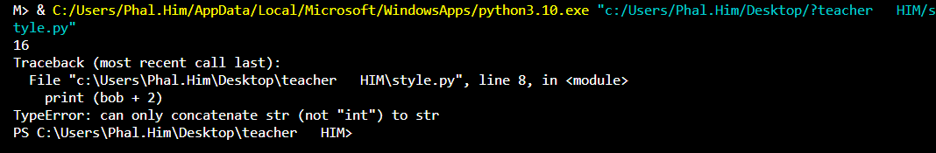
QUIZ
What will this code display on the console ?
5 MIN
CLASS
bob = "16"
print( bob )
print( bob + 2 )
ERROR
bob

Slide 16
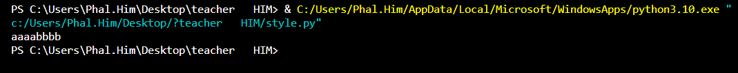
QUIZ
What will this code display on the console ?
5 MIN
CLASS
bob = “aaaa" + “bbbb"
print(bob)
bob

Slide 17
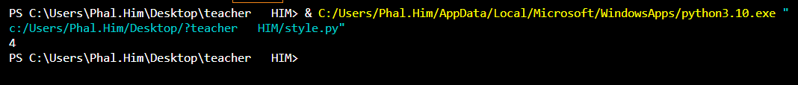
QUIZ
What will this code display on the console ?
5 MIN
CLASS
n = "test"
x = len(n)
4
>
print(x)

Slide 18
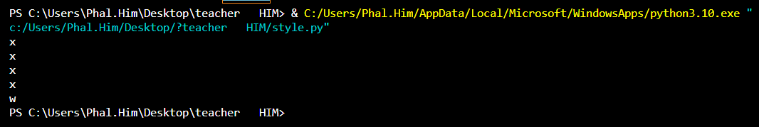
QUIZ
What will this code display on the console ?
5 MIN
CLASS
n = 4
for i in range(n):
print("x")
print("w")
X
X
X
X
W
>

Slide 19
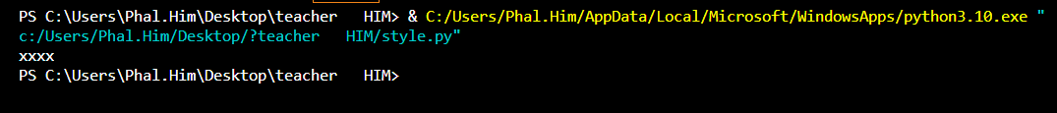
QUIZ
What will this code display on the console ?
5 MIN
CLASS
n = 4
text = ""
for i in range(n):
text = text + "x"
print(text)
>
n
text

Slide 20
PRACTICE
Find the code to display this on the console
1
10 MIN
CLASS
X
XX
XXX
XXXX
XXXXX
>
5
Notes:
numberOfX = 1
for i in range(5) :
for j in range(numberOfX) :
print("X", end="")
print()
numberOfX = numberOfX +1

Slide 21

What is a string
How to concatenate string
How get the number of characters of a string
How to use the carriage return ‘\n’ character
How to enter a string in the console
How to print a string to the console
YOU KNOW
SO NOW OPEN GOOGLE FROM
AND LET’S WORK

